Slide 1


Welcome to PowerPoint
Hotel Aggregator Analysis
-Power BI-
By Manglam Raj
5 tips for a simpler way to work

Slide 2
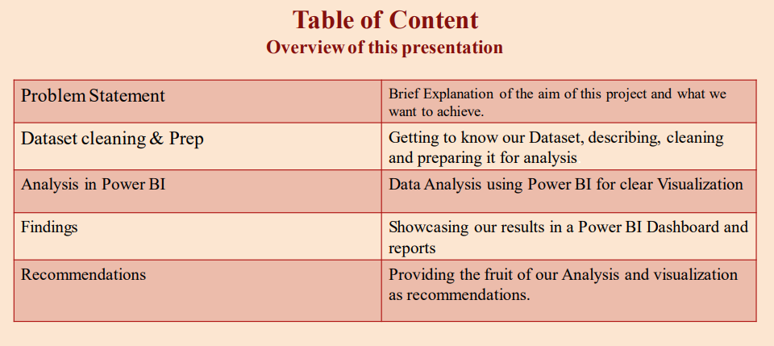

Designer helps you get your point across

Slide 3

Problem Statement
We will cover the experience of analyzing a hotel aggregator dataset using Power BI including visualizations, trends, patterns, and factors influencing listing performance in order to provide actionable insights for improving listing quality and competitiveness

Slide 4
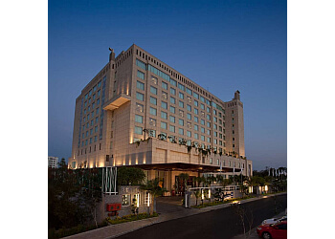
Dataset Cleaning & Preparation
Connecting Microsoft Power BI to our Dataset
Checking for null/duplicate/irrelevant values or columns
Starting up our Data exploration & Analysis

Slide 5
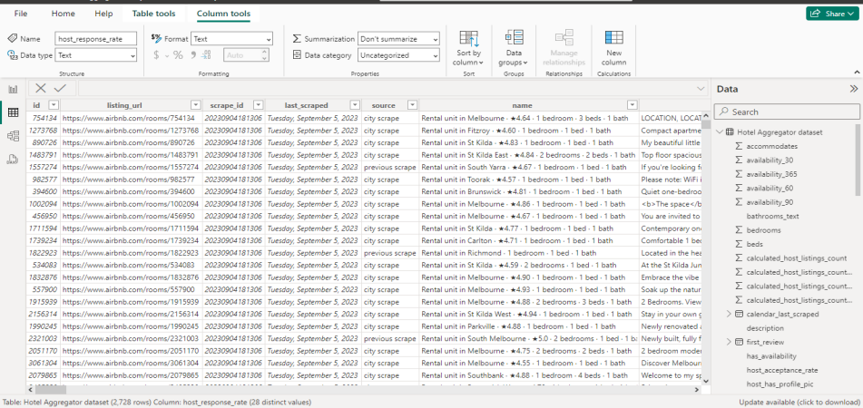
Load the dataset in Power BI

Slide 6
2 Data Analysis in Power BI
Geographical distribution
To identify popular neighborhoods, we Explore the geographical concentration of listings and host locations.
Pricing trends
We analyze pricing trends based on property types, room types, and accommodation capacity.
Host Characteristics
Including superhost status, response times, and verification methods.
Review Scores
We try to identify areas for improvement based on specific review categories.

Slide 7
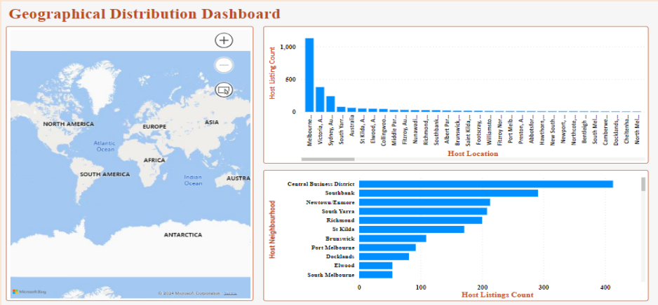
3

Slide 8
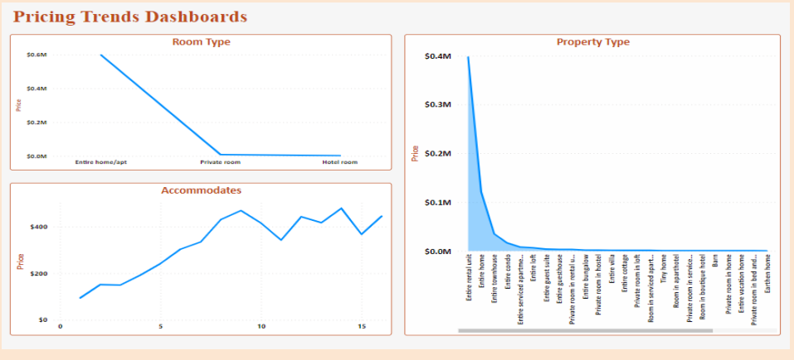
4

Slide 9
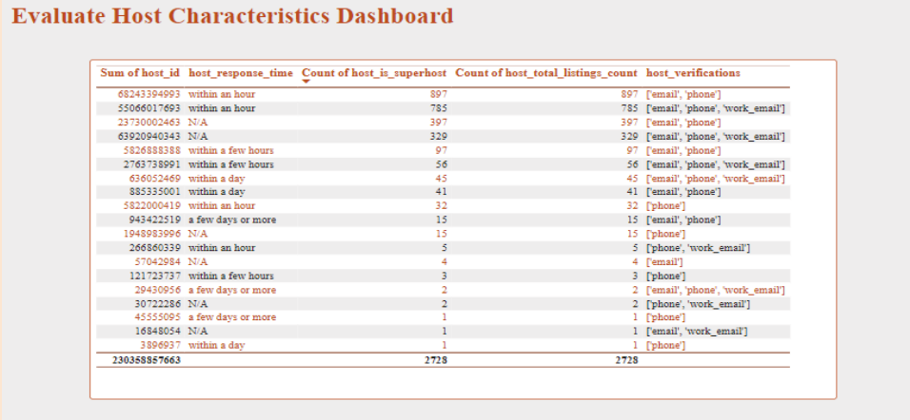
5

Slide 10
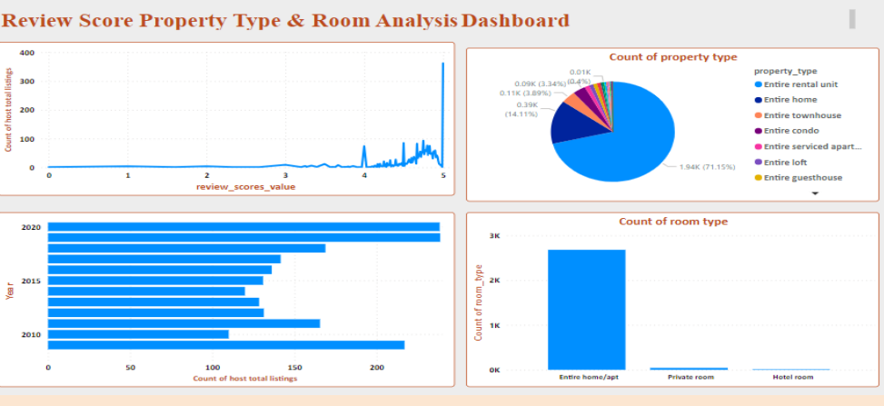
6

Slide 11
THANK YOU

